Slide 1
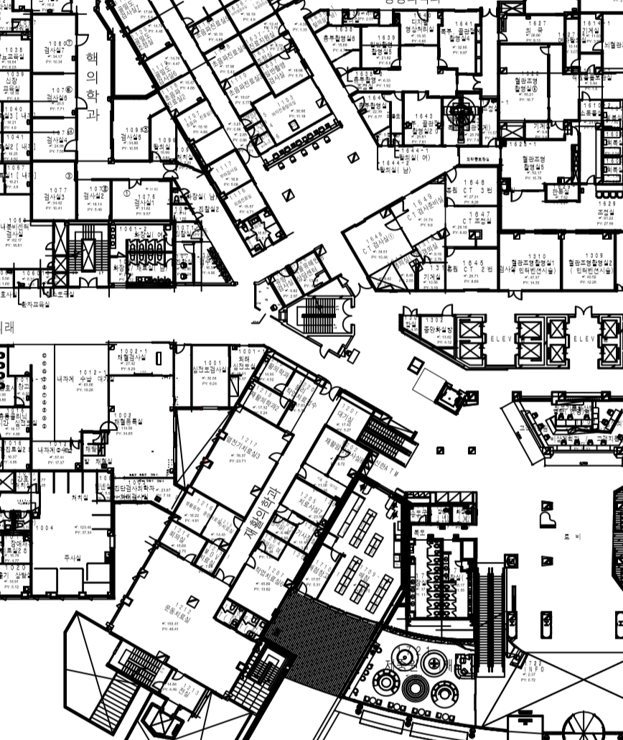

Slide 2
waypoint

Slide 3
Waypoint modified
13
14
11
12

Slide 4
7
waypoint
6
5
8
10
4
2
9
3
1
0

Slide 6
Map_edge

Slide 7
obstacle1

Slide 8
Obstacle_2

Slide 9
Obstacle_3

Slide 10
Obstacle_4

Slide 11
Obstacle_5

Slide 12
Obstacle_6

Slide 13
Obstacle_7

Slide 14
Obstacle_8

Slide 15
Obstacle_9

Slide 16
Toy corner obs0

Slide 17
Toy corner obs1

Slide 18
Toy corner waypoint

Slide 19
Toy corner wo obstacle obs0

Slide 20
Toy corner wo obstacle obs0

Slide 21
Straight toy obs0

Slide 22
Straight toy waypoint

Slide 23
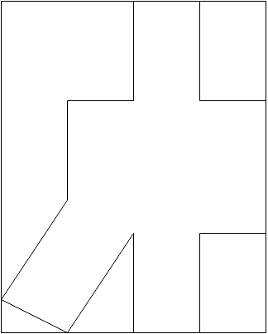

Slide 26
3
4
5
6
8
1
7
9
2
0

Slide 27
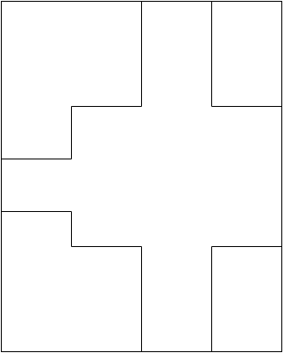

Slide 30
3
4
5
2
7
1
6
9
8
0

Slide 31
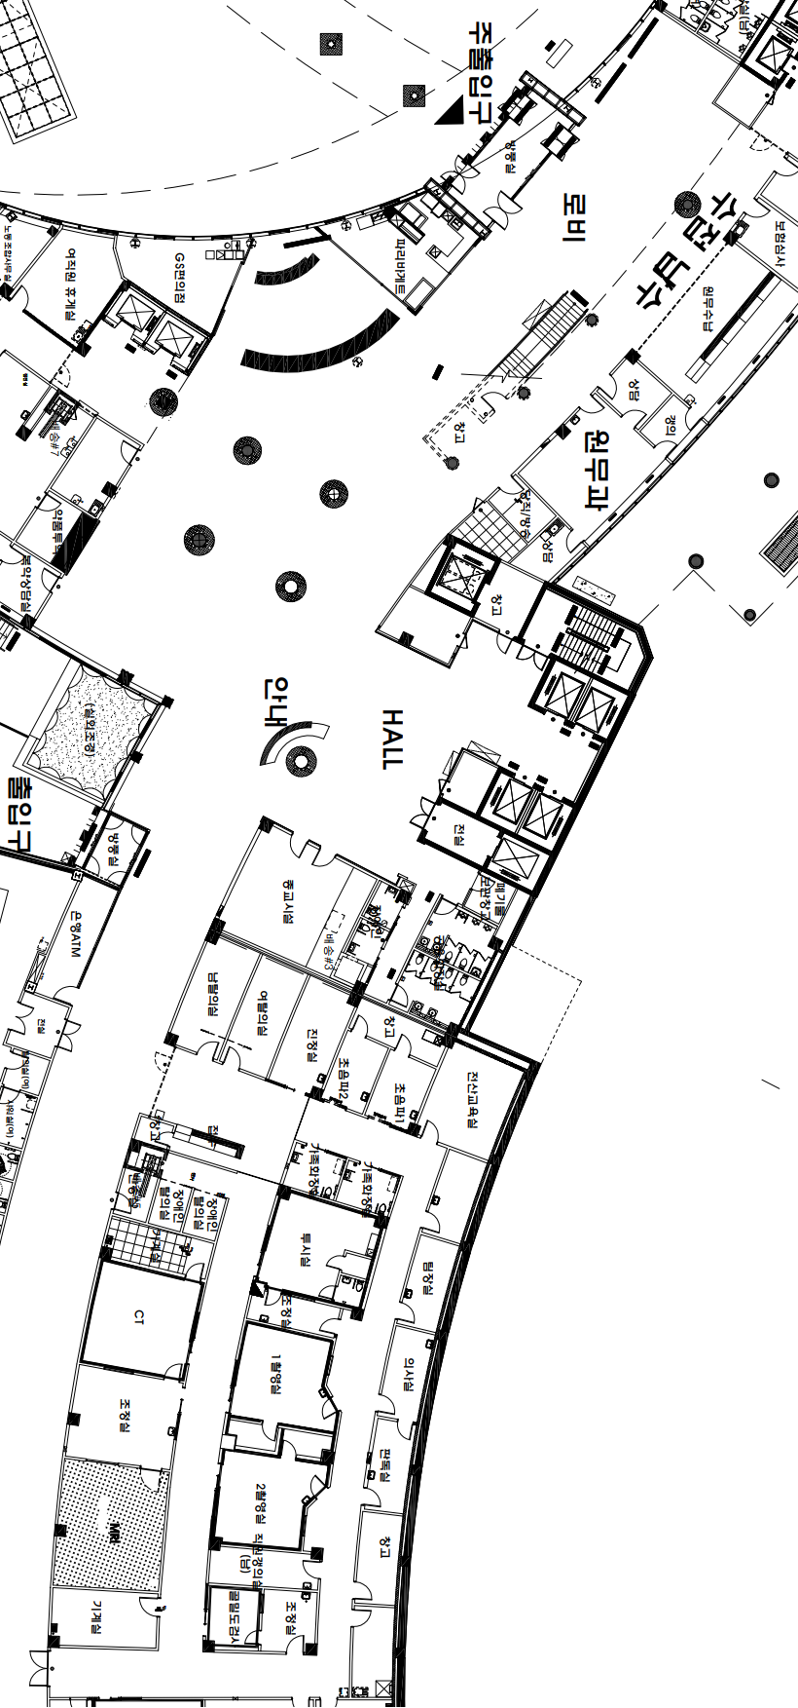

Slide 37
0
1
2
7
8
9
3
4
5
6

